Slide 1
Introduction to JS And
JS fundamentals
Session 9
(slot 15-16)

Slide 2
Objectives
Introduce JavaScript language
Explain variables and data type
Explain operators
Explain if, switch-case statements
Explain loop statements

Slide 3
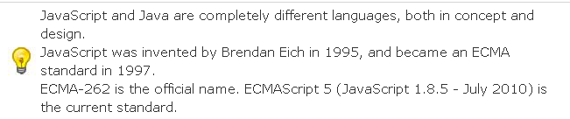
JavaScript Introduction
what JavaScript can do?.
JS where to
JavaScript Can Change HTML Content
JavaScript Can Change HTML Attributes
JavaScript Can Change HTML Styles (CSS)
JavaScript Can Validate Data
external
internal
HTML
HTML
Code Js
Code Js

Slide 4
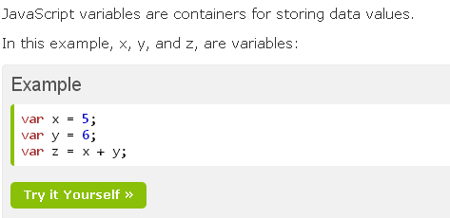
Variables and Data Type

Slide 5
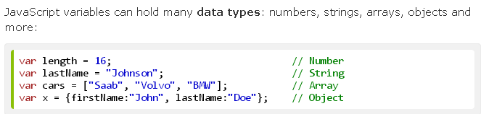
Variables and Data Type

Slide 6
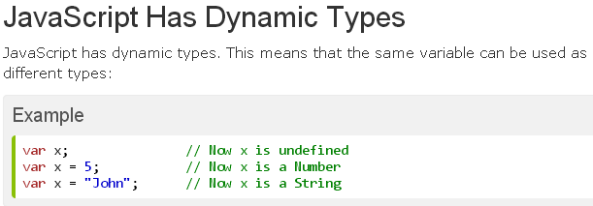
Variables and Data Type

Slide 7
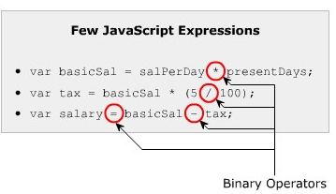
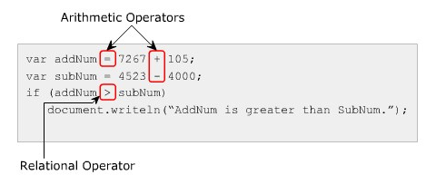
Types of Operators
Operators help in simplifying expressions.
JavaScript provides a predefined set of operators that allow you to perform different operations.
Arithmetic operators
Relational operators
Logical operators
Assignment operators
Bitwise operators
Special operators

Slide 8
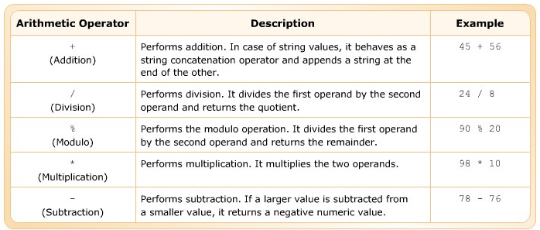
Arithmetic Operator
Arithmetic operators are binary operators, as they perform basic arithmetic operator on two operand.

Slide 9
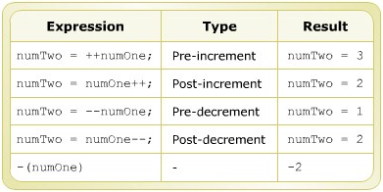
Increment and decrement operators
The increment operator (++) increases the value by 1, while the decrement operator(--) decreases the value by 1.

Slide 10
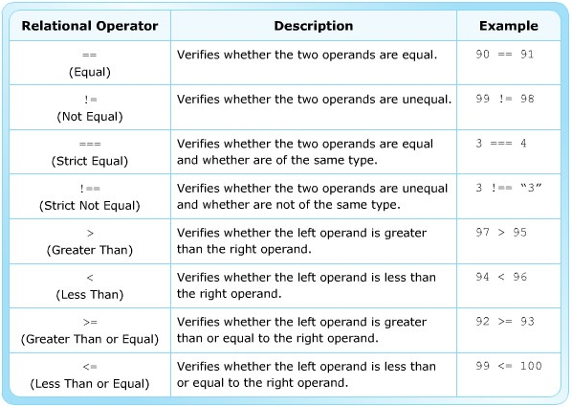
Relational Operators
Relational operators are binary operators that make compare between two operands. They return a Boolean value namely, true or false.

Slide 11
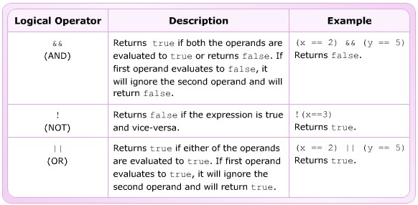
Logical Operators
Logical operators are binary operators that perform logical operations on two operands.

Slide 12
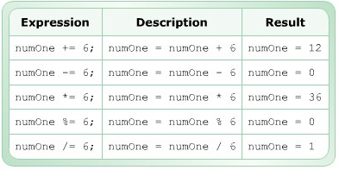
Assignment Operators
Assignment operator performs operations between the two operands and assign the result to its left operand.

Slide 13
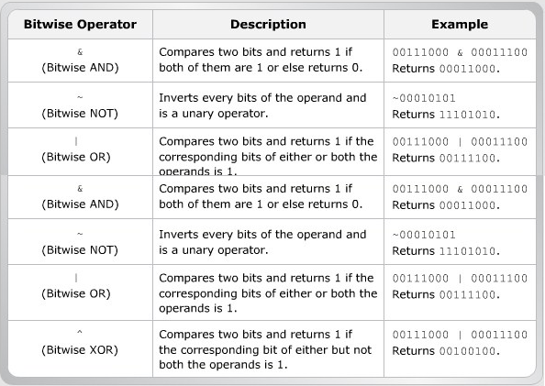
Bitwise Operators
Bitwise operators perform operations on the corresponding individual bits of two operands.

Slide 14
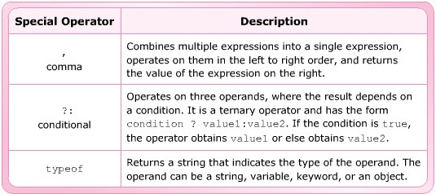
Special Operators
There are some operators in JavaScript, which do not belong to any of the categories of JavaScript operators

Slide 15
String Operators
Can merge two string values that are assigned to two different variables.
Operator | Description | Example
+ | Concatenates two or more strings into a single string | var fullname=‘John’ + ‘ ’ + ‘Blake’; fullname=‘John Blake’
+= (Add-By-Value) | Concatenates to or more strings and assign the result to its left operant | var flower=‘Rose’; flower +=‘’ + ‘flower’; flower =‘Rose Flower’;

Slide 16
Shift Operators
Shift operators are binary bitwise operators that perform shift operations on bits. The first operand is the decimal number on which the shift operation is performed. The second operand specifies the number or bit positions by which the bits are to be shifted.
Operator | Description | Example
<< (Left Shift Operator) | Shift the bit positions towards the left by shifting the number of bits in the left at the right | 8<<2 yield 32,because 00001000 shifted by 2 bits becomes 00100000,which is 32. Here, the two leftmost bits are placed toward the right
>> (Right Shift Operator) | Shift the bit positions towards the right by shifting the number of bits in the right at the left | 8>>2 yield 32,because 00001000 shifted by 2 bits becomes 00000010,which is 2. Here, the two rightmost bits are placed toward the left.

Slide 17
Decision – making Statement
Decision-making statement s allow implementing logical decision for executing different block to obtain the desired output. They execute a block of statements depending upon a Boolean condition.
This condition is an expression that returns either true or false.
JavaScript supports four decision-making statements :
  If
  If-else
  If-else if else
  switch

Slide 18
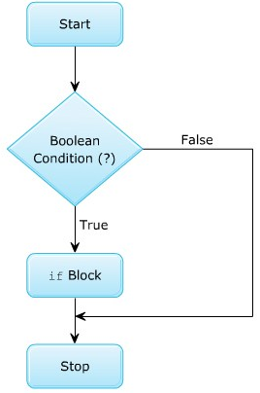

The “if” Statement
The if statement executes a block of statements based on a logical Boolean condition.

Slide 19
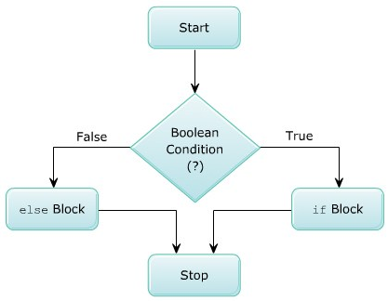
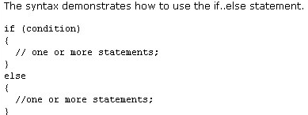
The “if-else” Statement
The if statement specifies a block of statement to be executed when the condition in the if statement is true, and it’s requires to define a block of statements to be executed when a conditions evaluated to false

Slide 20
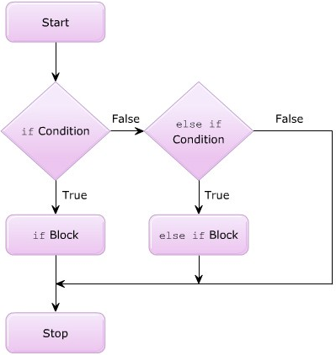
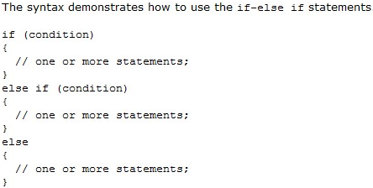
The “if-else if ” Statement
The if-else if statements allow you to check multiple conditions and specify a different block to be execute for each condition.

Slide 21
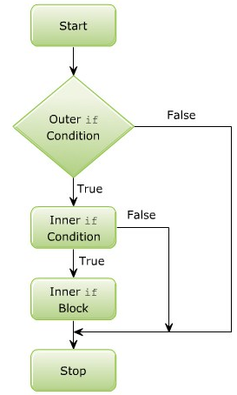
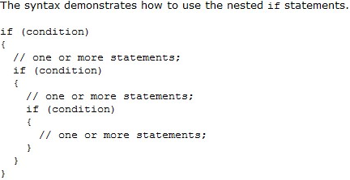
Nested “if” Statement
The nested if statements comprises of multiple if statements within an if statement.

Slide 22
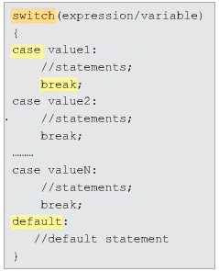
“Switch-case” Statement
To simplify the coding and avoid using multiple if statement, switch-case statement can be used as a different approach to code the same logic

Slide 23
Loop statements
Describe while loop.
Explain for loop.
Describe do-while loop.
Explain break and continue statements.

Slide 24


What is a loop?
Loop is a section of code in a program which is executed repeatedly, until a specific condition is satisfied.
There are three type of loop structures:
The while loop
The do-while loop
The for loop

Slide 25
The while loop
The while loop executes a block of code as long as the given condition remains true.
Syntax:
while (condition)
{
statement(s);
}
Condition
false
true
Execute body
of loop
Exit loop

Slide 26
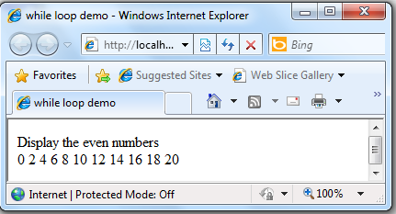
The while loop: Demo
<html xmlns="http://www.w3.org/1999/xhtml">
<head>
<title>while loop demo</title>
<script language="javascript" type="text/javascript">
var n=20;
var i=0;
document.write("Display the odd number <br>");
while(i<=n)
{
if(i%2 == 0)
document.write(i + "\t");
i++;
}
</script>
</head>
<body>
</body>
</html>

Slide 27
The do-while loop
The do-while loop is similar to the while loop, but the do-while loop evaluates the condition at the end of the loop. So that, the do-while loop executes at least once.
Syntax:
do
{
statement(s);
}while(condition);
do
Execute body
of loop
Condition
true
false
Exit loop

Slide 28
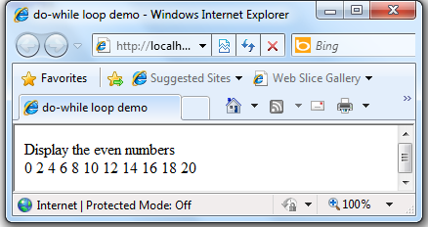
The do-while loop: Demo
<html xmlns="http://www.w3.org/1999/xhtml">
<head>
<title>while loop demo</title>
<script language="javascript" type="text/javascript">
var n=20;
var i=0;
document.write("Display the even number <br>");
do
{
if(i%2 == 0)
document.write(i + "\t");
i++;
} while(i<=n);
</script>
</head>
<body>
</body>
</html>

Slide 29
The for loop
Syntax:
for(initialization; condition; increment/decrement)
{
statement(s);
}
The initialization is an assignment statement that sets the loop control variable, before entering the loop.
The condition is a relational expression, which determines, when the loop will exit.
The increment/decrement defines how the loop control variable changes, each time the loop is executed.

Slide 30
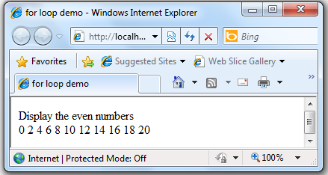
The for loop: Demo
<html xmlns="http://www.w3.org/1999/xhtml">
<head>
<title>for loop demo</title>
<script language="javascript" type="text/javascript">
var n=20;
var i=0;
document.write("Display the even number <br>");
for(i=0; i<n; i++)
{
if(i%2 == 0)
document.write(i + "\t");
}
</script>
</head>
<body>
</body>
</html>

Slide 31
break statement
The break statement can be used in the switch-case and loop constructs. It is used to exit the loop without evaluating the specified condition.
for(initialization; condition; increment/decrement)
{
….
if(condition)
break;
…
}
...

Slide 32
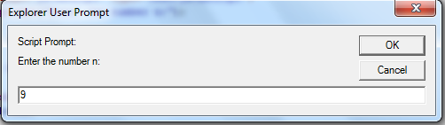
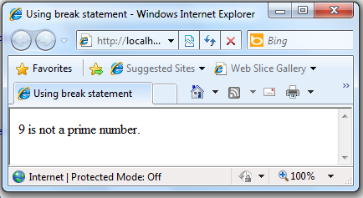
break statement: Demo
<html xmlns="http://www.w3.org/1999/xhtml">
<head>
<title>Using break statement</title>
<script language="javascript" type="text/javascript">
var n = prompt("Enter the number n:");
var i=0;
for(i=2; i<n; i++)
{
if(n % i == 0)
{
document.write(n + " is not a prime number.");
break;
}
}
if(i == n)
document.write(n + " is prime number.");
</script>
</head>
</html>

Slide 33
continue statement
The continue statement is mostly used in the loop constructs. It is used to terminate the current execution of the loop and continue with the next repetition by returning the control to the beginning of the loop.
for(initialization; condition; increment/decrement)
{
….
if(condition)
continue;
…
}
...

Slide 34
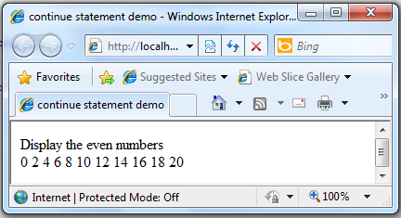
continue statement: Demo
<html xmlns="http://www.w3.org/1999/xhtml">
<head>
<title>continue statement demo</title>
<script language="javascript" type="text/javascript">
var n=20;
var i=0;
document.write("Display the even numbers <br>");
for(i=0; i<=n; i++)
{
if(i%2 == 1)
continue;
else
document.write(i + "\t");
}
</script>
</head>
</html>

Slide 35
Summary
The & operator perform bitwise AND operation and returns the result to the operand on the left hand side
The | operator performs bitwise OR operation and returns the result to the operand on the left hand side
The ^ operator performs bitwise XOR operation and returns the result to the operand on the left hand side
The string concatenation operator combine different strings into single string.

Slide 36
Summary…
The left shift operator shifts the bits on the leftmost side toward the right.
The right shift operator shifts the bits on the rightmost side toward the left.
Nested switch-case construct refers to including a switch-case construct within a case block.
JavaScript support three types of loop:
  while loop
  for loop
  do….while loop
Jump statements: break, continue

Slide 37
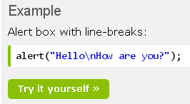
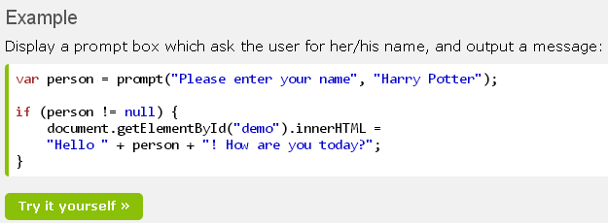
exercise

Slide 38
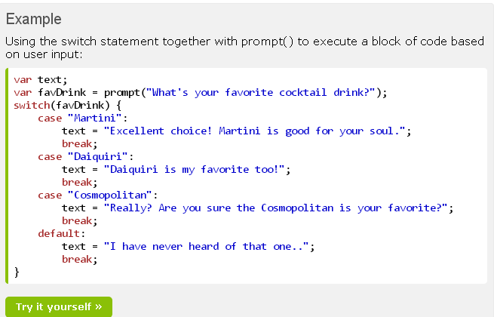
exercise

Slide 39
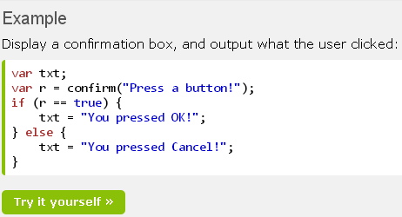
exercise

